Slide 1

UNIT 1: Who am I?
Who are you?

Slide 2
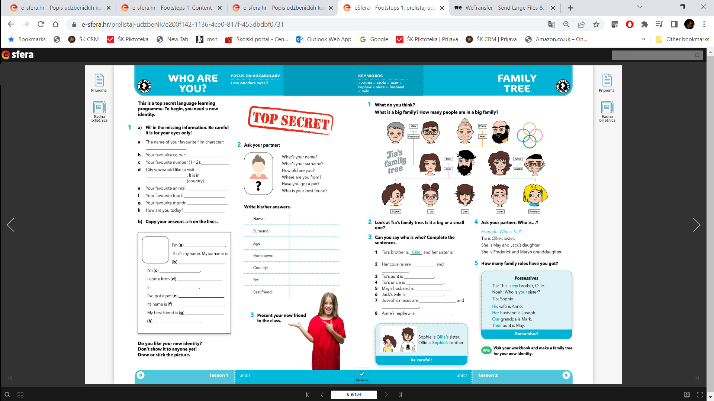
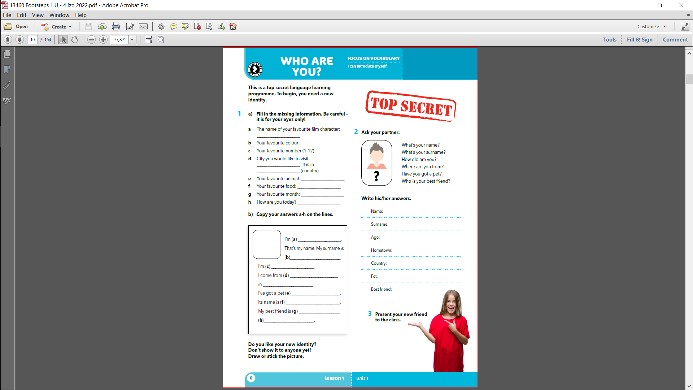

Slide 5
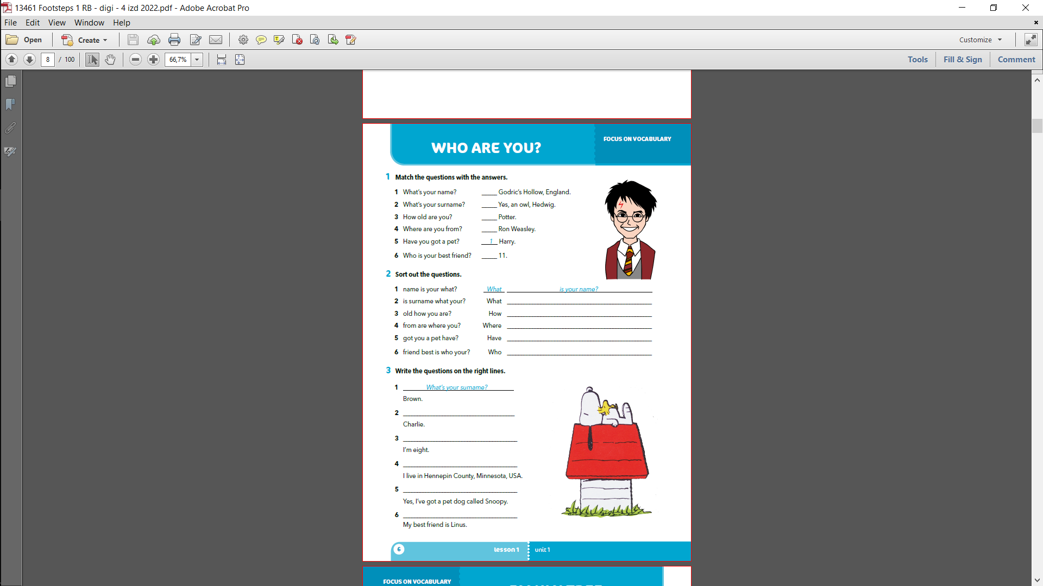
4
5
2
6
3

Slide 6
is your surname?
old are you?
are you from?
you got a pet?
is your best friend?

Slide 7
What is your name?
How old are you?
Where do you live?
Have you got a pet?
Who is your best friend?

